Slide 1
RamSync Investment Analysis
Jacob Baron, Ben Hoffman, Lucas Lantis, Reid Zuerlein

Slide 2
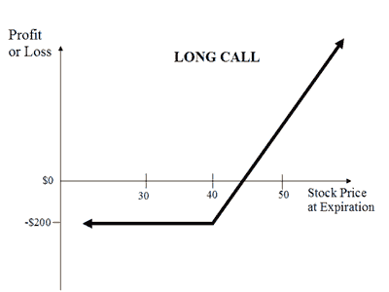
What is a Financial Option
A financial option is a contract which grants one party the right to purchase or sell an asset within the agreed upon timeframe and at the specified price.
Example: Call Option on Stock
Buyer (Long call) & Seller (Short call)
Both parties agree that the buyer has a right to purchase 100 shares
at the strike price, and the buyer pays the seller a premium
If the stock price of the underlying asset appreciates, the long position
holder can profit by exercising the contract, purchasing shares at the
strike price, and reselling at the higher market valuation.

Slide 3
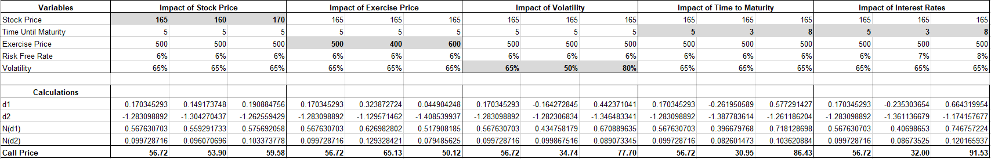
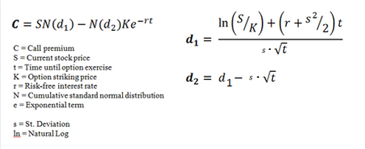
Factors Which Impact Call Price

Slide 4
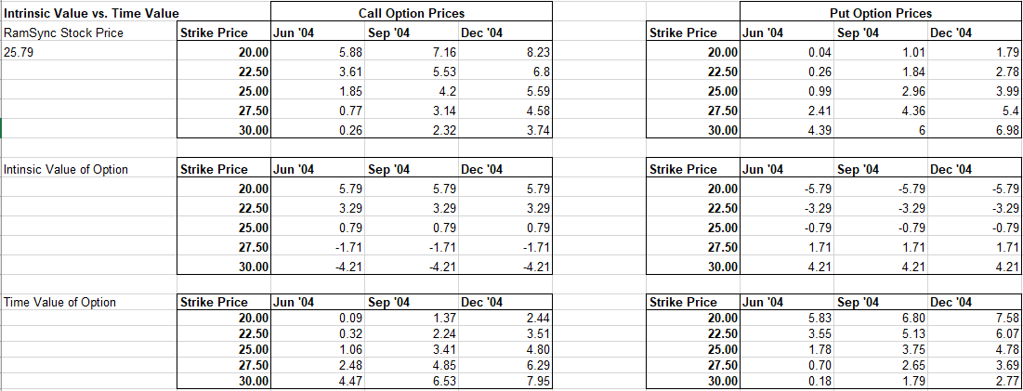
Call Option: Intrinsic Value vs Time Value
Intrinsic Value = Stock Price – Strike Price
Represents the portion of the option’s premium that is in-the-money
Time Value = Premium – Intrinsic Value
Premium is the price the buyer pays and the seller receives

Slide 5
Can This be Used to Analyze the MRAM Growth Option?
While the Black Scholes model was initially developed for options pricing, it is not uncommon for it to be used when analyzing more vanilla investments or capital budgeting
The same inputs in the Black Scholes model like time to maturity, the risk-free rate, underlying asset price, and interest rates are all relevant to the hedge fund’s analysis
A project has a ‘Real Option’ when management can abandon, invest more, or ignore a project in response to unforeseen future events
This is applicable to RamSync, because the hedge fund will likely have to opportunity to maintain ownership or exit the investment depending on performance

Slide 6
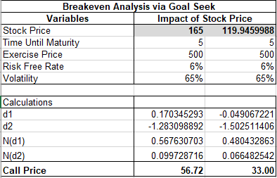
MRAM Venture Profitability
While RamSync’s regular operations have a -$33m NPV, a potential new project into MRAM technology could overcome this and generate positive returns
Black Scholes Model Assumptions
DCFs = $165m
5 Year Time Frame
$500m Investment
6% Risk-Free Rate
65% DCF Volatility
Breaks even with a NPV of $33m

Slide 7
Biggest Risks
We believe that the biggest risk towards RamSync becoming a profitable investment is the accuracy of their MRAM DCF projections
Currently, their projections suggest that this is a worthwhile venture for the hedge fund
If their DCF projections are inaccurate, a key input into our Black Scholes model will be incorrect and this would lead to a misevaluation of the project
DCF Volatility is one method of examining this risk
Volatility is how susceptible something is to rapid and unpredictable changes
The less volatile RamSync’s DCF projections are when looking at past annual reports compared to actual results, the higher our confidence is that our model is accurate

Slide 8
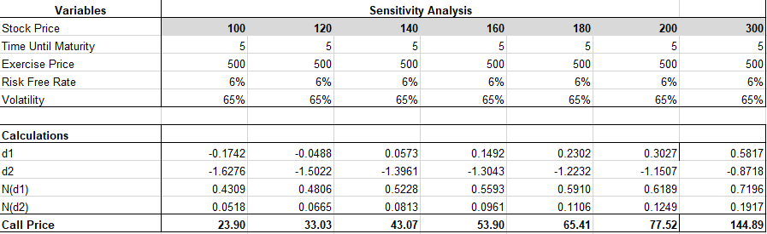
Sensitivity Analysis

